Slide 1
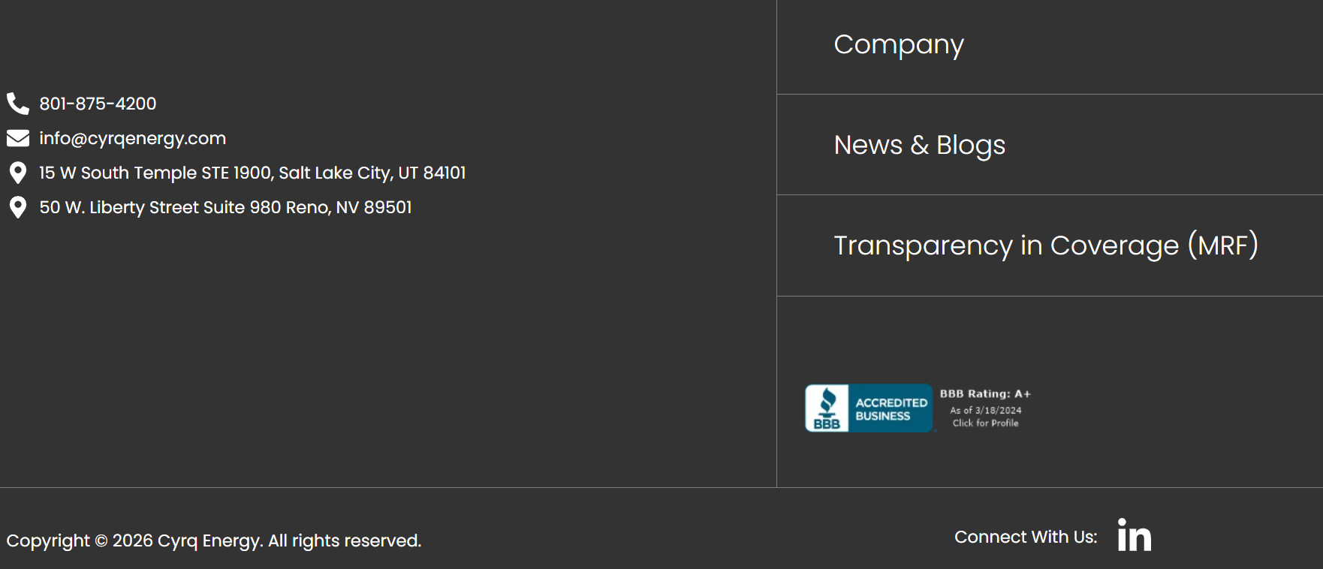
In the footer of the company website add “Contractor Safety Orientation”
Contractor/Visitor Safety Orientation

Slide 2
Either via dropdown or the linked page have 2 options:
  Orientation Website
  Registration Instructions
Contractor/Visitor Safety Orientation

Slide 3
Orientation Website - https://cyrqenergycontractor.contractortrainingonline.com/CyrqTraining
Registration Instructions – Sent as additional power point
Contractor/Visitor Safety Orientation

