Slide 1
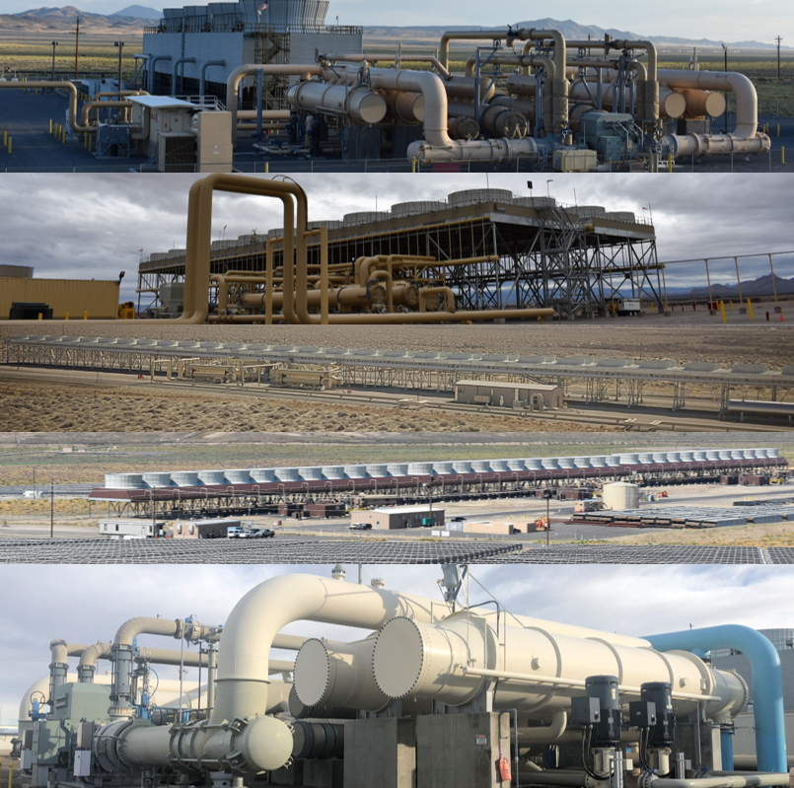

Cyrq Energy, LLC
Contractor Onboarding Training
STRICTLY PRIVATE

Slide 2
General Notes
Prior to arriving and working onsite you must complete the associated general and local site training
  Training must be performed annually
After the training click “Complete Training” and then close the window
Recommended browser is google chrome

Slide 3
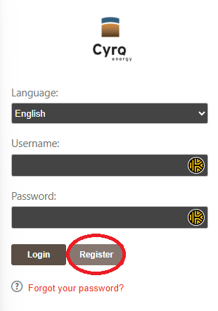
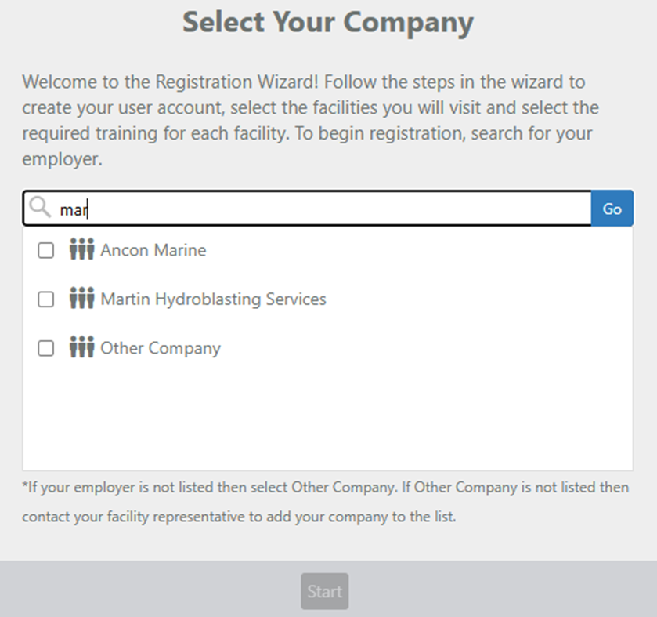
Register
Go to the contractor training site and click register.https://cyrqenergycontractor.contractortrainingonline.com/CyrqTraining
Put in the name of your company (at least 3 letters), and search for your company, click it and select start

Slide 4
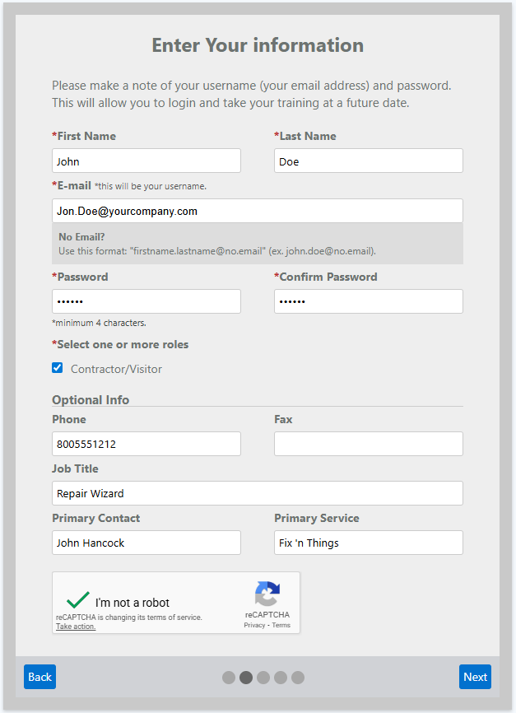
Fill out your information
Fill out your name
Put in your company email, if you don’t have an email put in firstname.lastname@no.email
Set your password
Select contractor/Visitor
Set your phone number
Job Title
Company contact
Service your company provides
Select Next

Slide 5
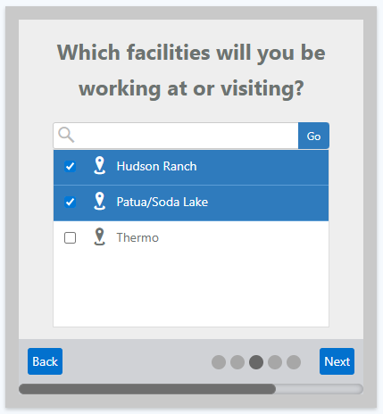
Select the sites you work at
Select the sites you will be working at, you can always add more sites later
Click Next

Slide 6
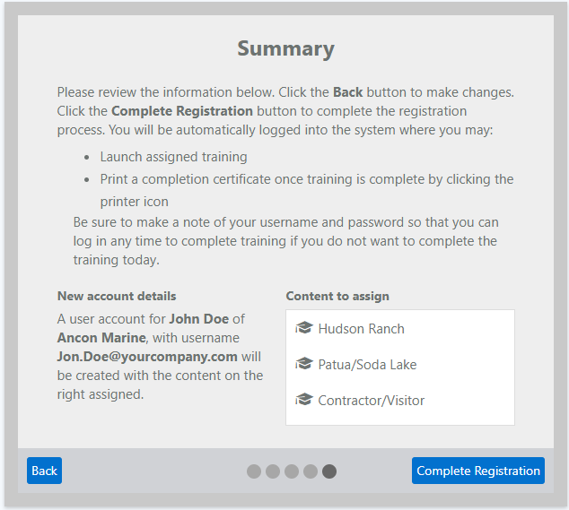
Review Data
Review the data, click back if you need to modify anything.
If everything is accurate, select complete registration.

Slide 7
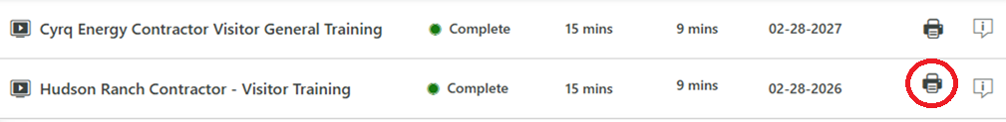
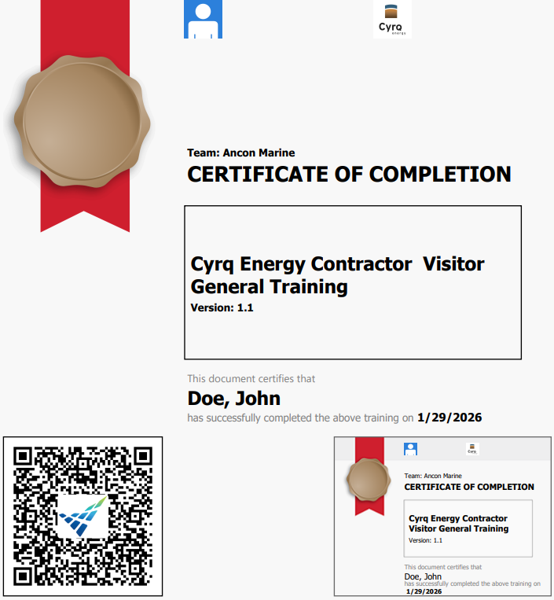
Print completed training
Click the print icon for the local site training
  If the certificate does not appear within 3-5 seconds, verify your pop up blockers are off
Bring the completed training to the site

